Slide 1
Climate Data Explorer: An Interactive Analysis and Visualization Tool
Submitted for
Programming for AI ABAI5003L
Submitted by:
Namrata
(A25MTAI0002)

Slide 2
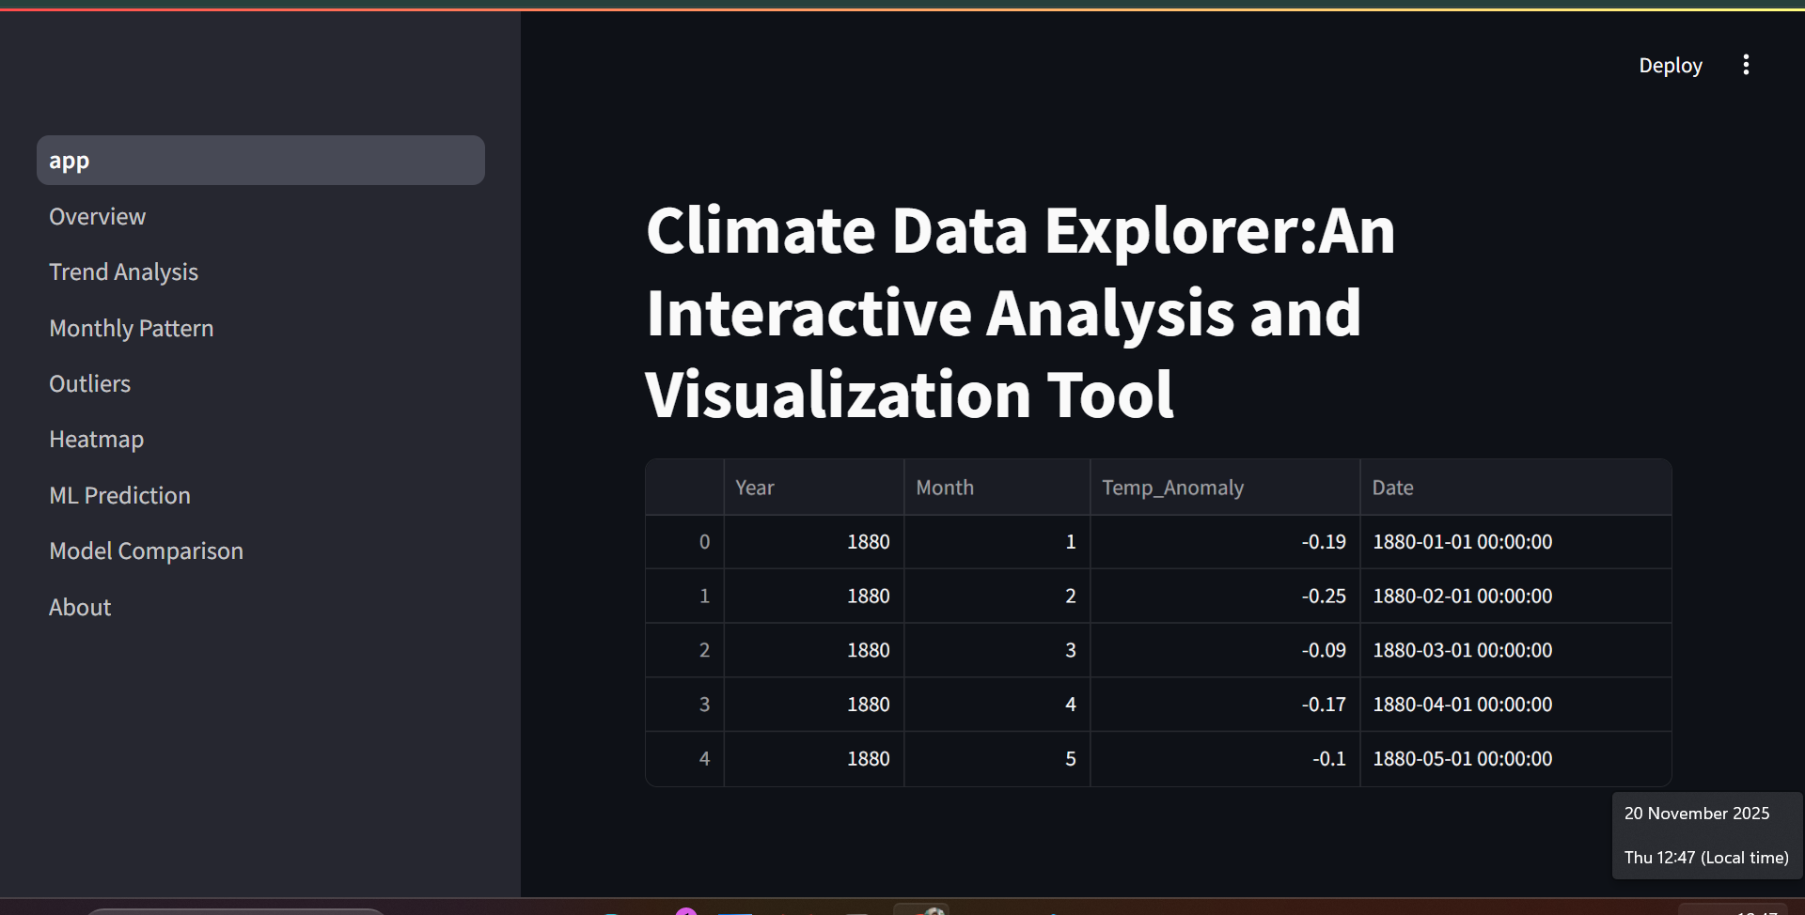
Introduction
Climate change is a major global challenge worldwide
Temperature anomaly analysis helps understand warming patterns
NASA GISTEMP dataset provides monthly global temperature anomalies from 1880–present
Dashboard performs real-time visualization and analysis
Includes trend analysis, seasonal pattern analysis, outlier detection, and forecasting

Slide 3
Datasets and Preprocessing
Removed all NaN rows to ensure clean dataset
Dataset used: NASA GISTEMP (Global Land-Ocean Temperature Index)
Data includes: Year, Months (Jan–Dec), Annual Mean
Steps performed in preprocessing:
Removed symbols (***) and converted them to NaN
Removed all NaN and duplicate values to ensure a clean dataset
Converted all temperature values to numeric
Reshaped to long format for time-series analysis
Created a proper “Date” column using Year + Month
Final dataset ready for visualization and ML models

Slide 4
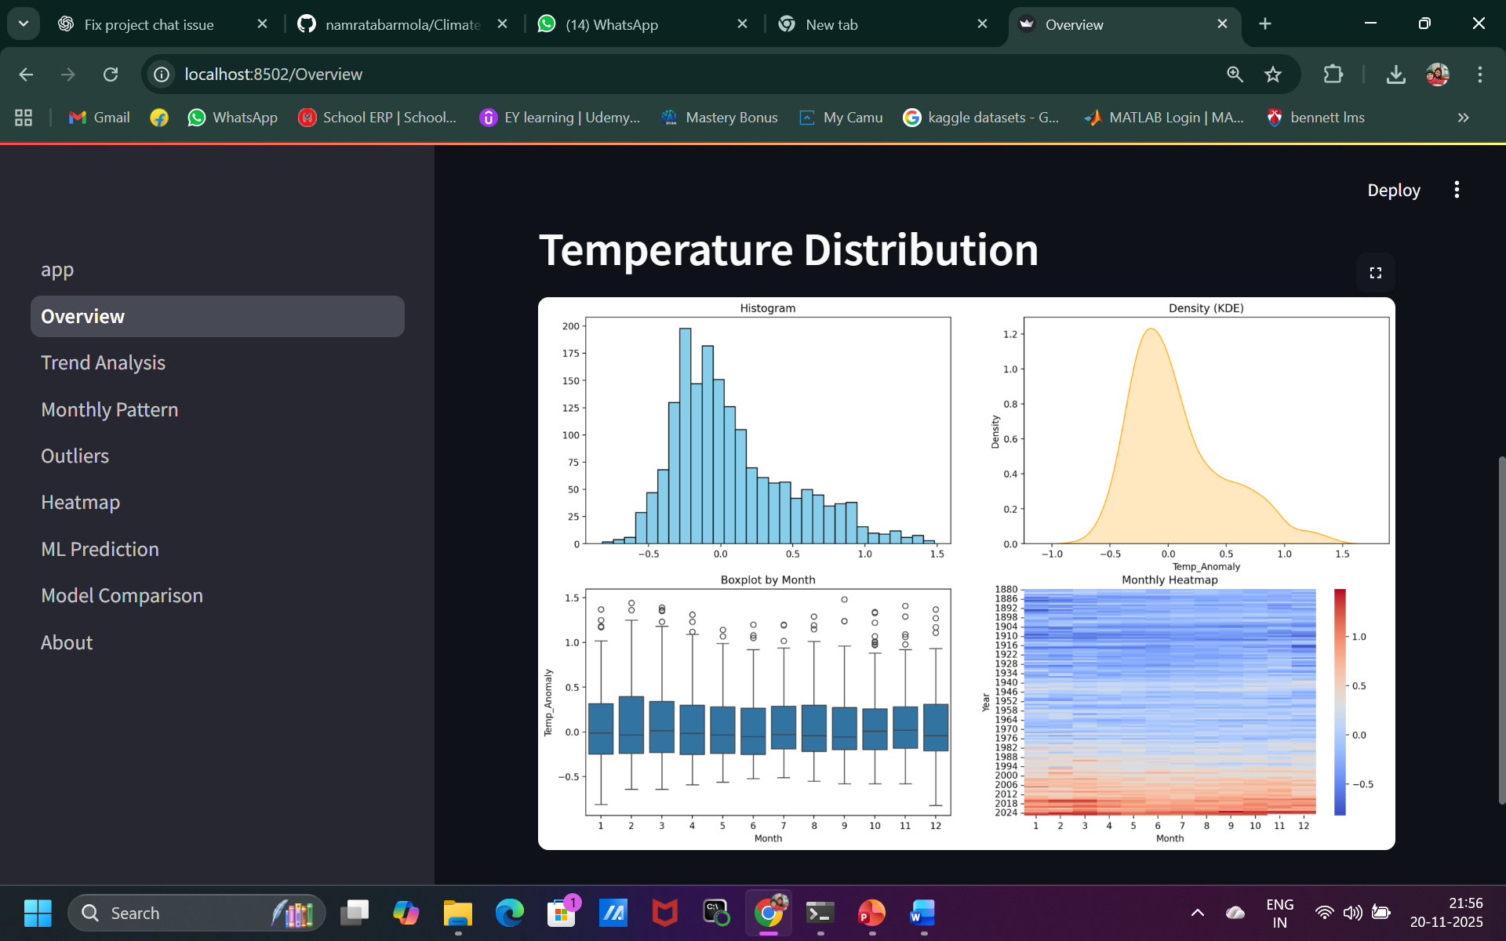
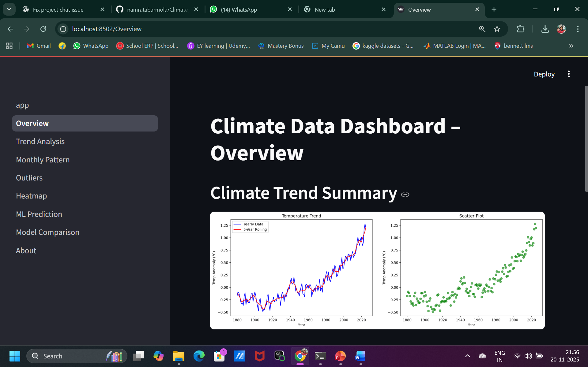
Overview Visualizations
Overview page provides first insight into the dataset
Displays:
Temperature anomaly trend (line graph)
Distribution of anomalies (histogram)
Monthly variation (bar plot / heatmap)
Helps identify long-term warming patterns
Gives a quick understanding of data behavior

Slide 5
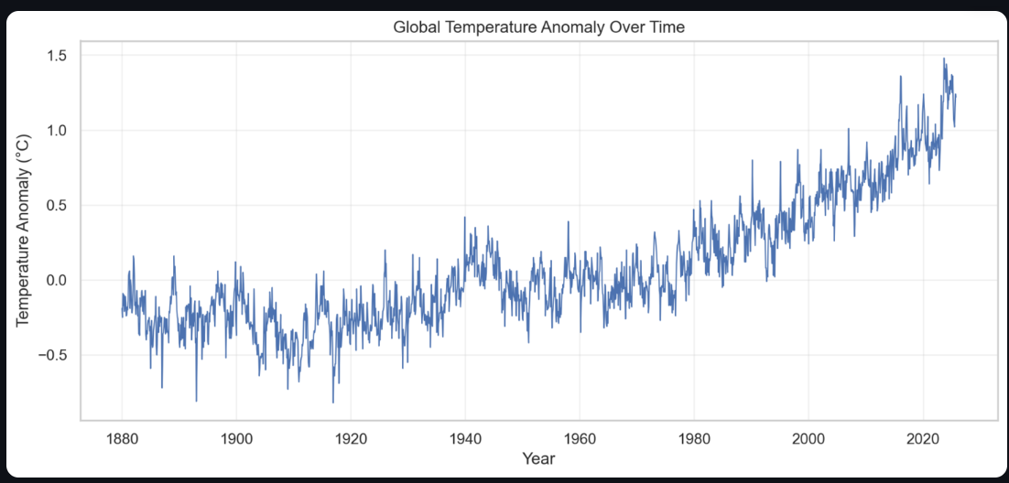
Trend Analysis
Line graph of temperature anomaly from 1880–2025
Shows a steady upward trend in global temperature
Sharp warming observed after 1980
Trend line helps forecast potential future warming
Trend Statistics
Slope: 0.008295712711159095
R²: 0.7653455581488171
p-value: 3.5484674714091836e-47

Slide 6
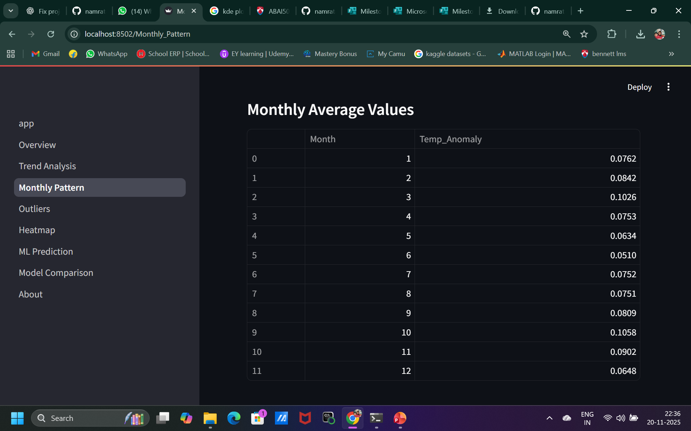
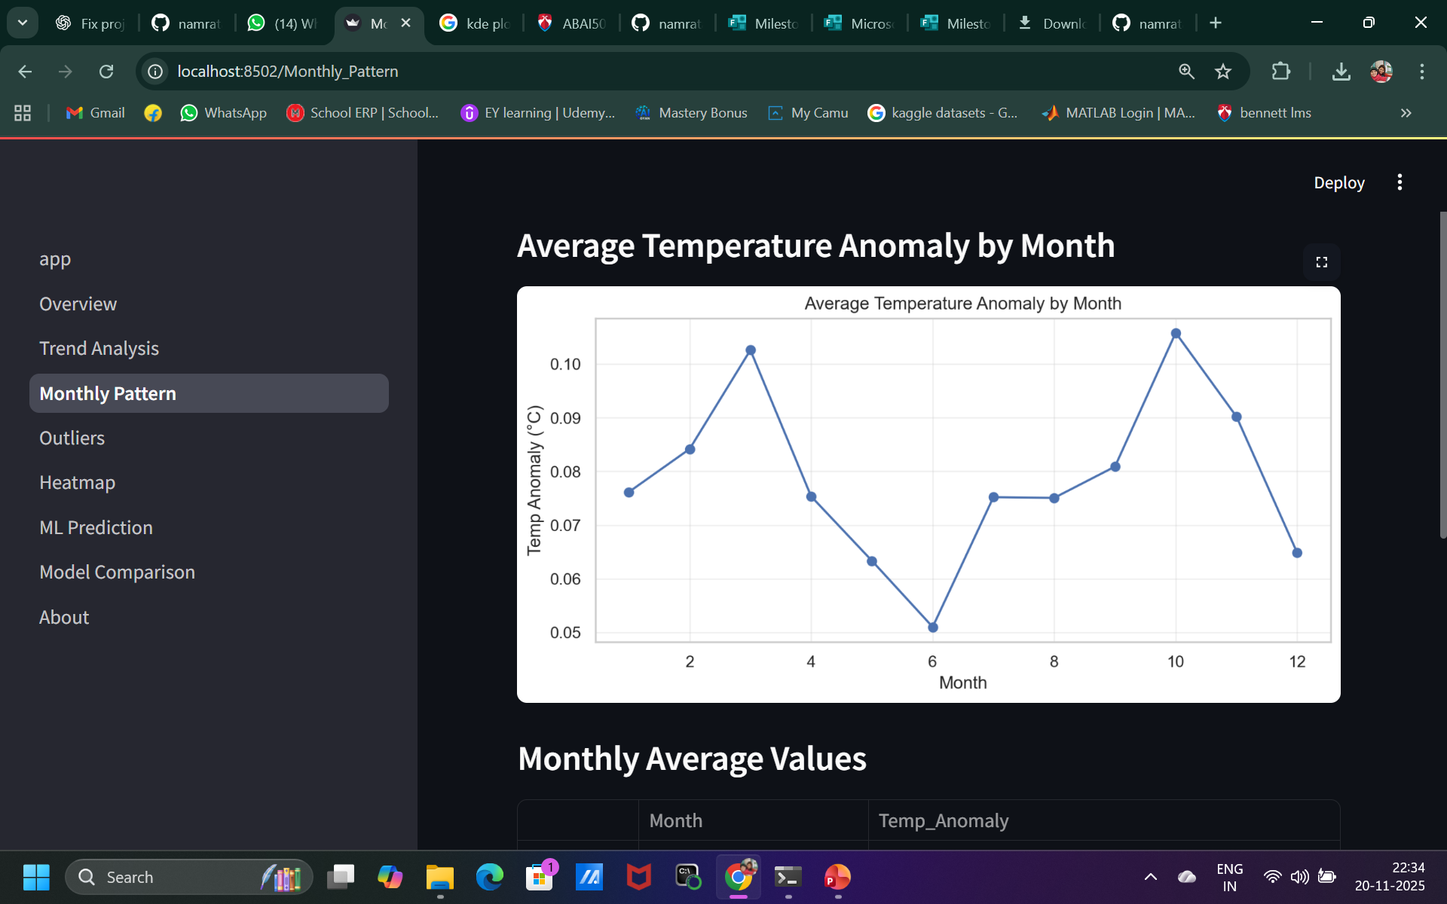
Monthly Pattern Analysis
Shows average temperature anomaly for each month
Reveals seasonal behavior of temperature changes
Summer months (Jun–Aug) show higher anomalies
Winter months (Jan–Feb) show lower anomalies
Monthly pattern shows consistent warming across all months
Confirms seasonal influence on global warming trends

Slide 7
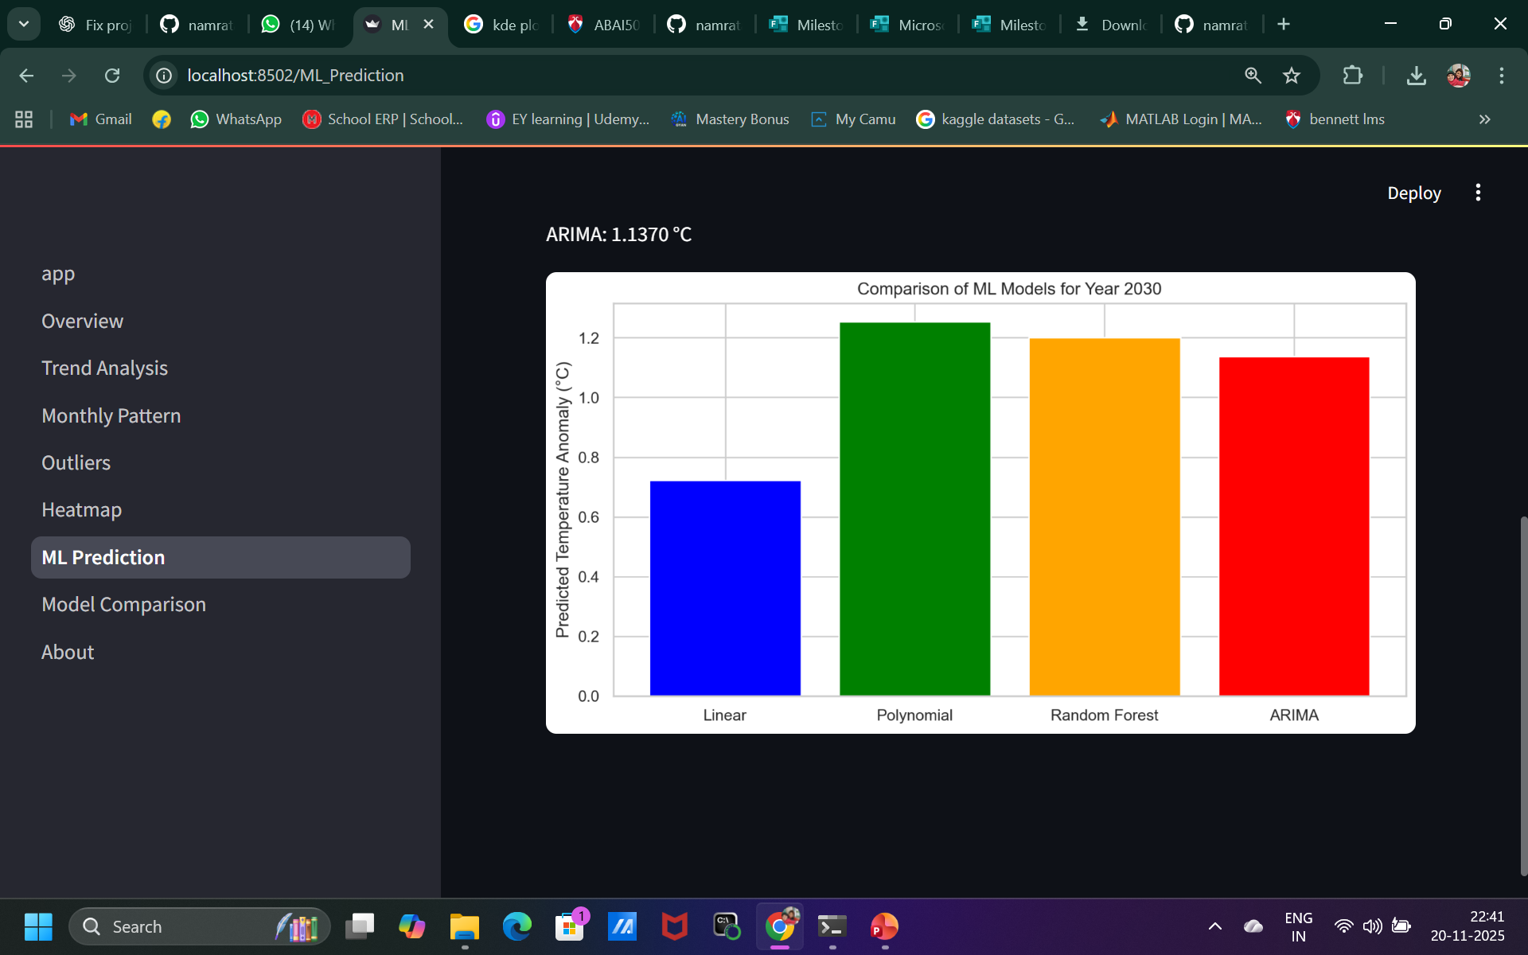
Machine Learning Predictions
Prediction Results
Linear Regression: 0.7229 °C
Polynomial Regression (degree 6): 1.2533 °C
Random Forest: 1.2014 °C
ARIMA: 1.1370 °C

Slide 8
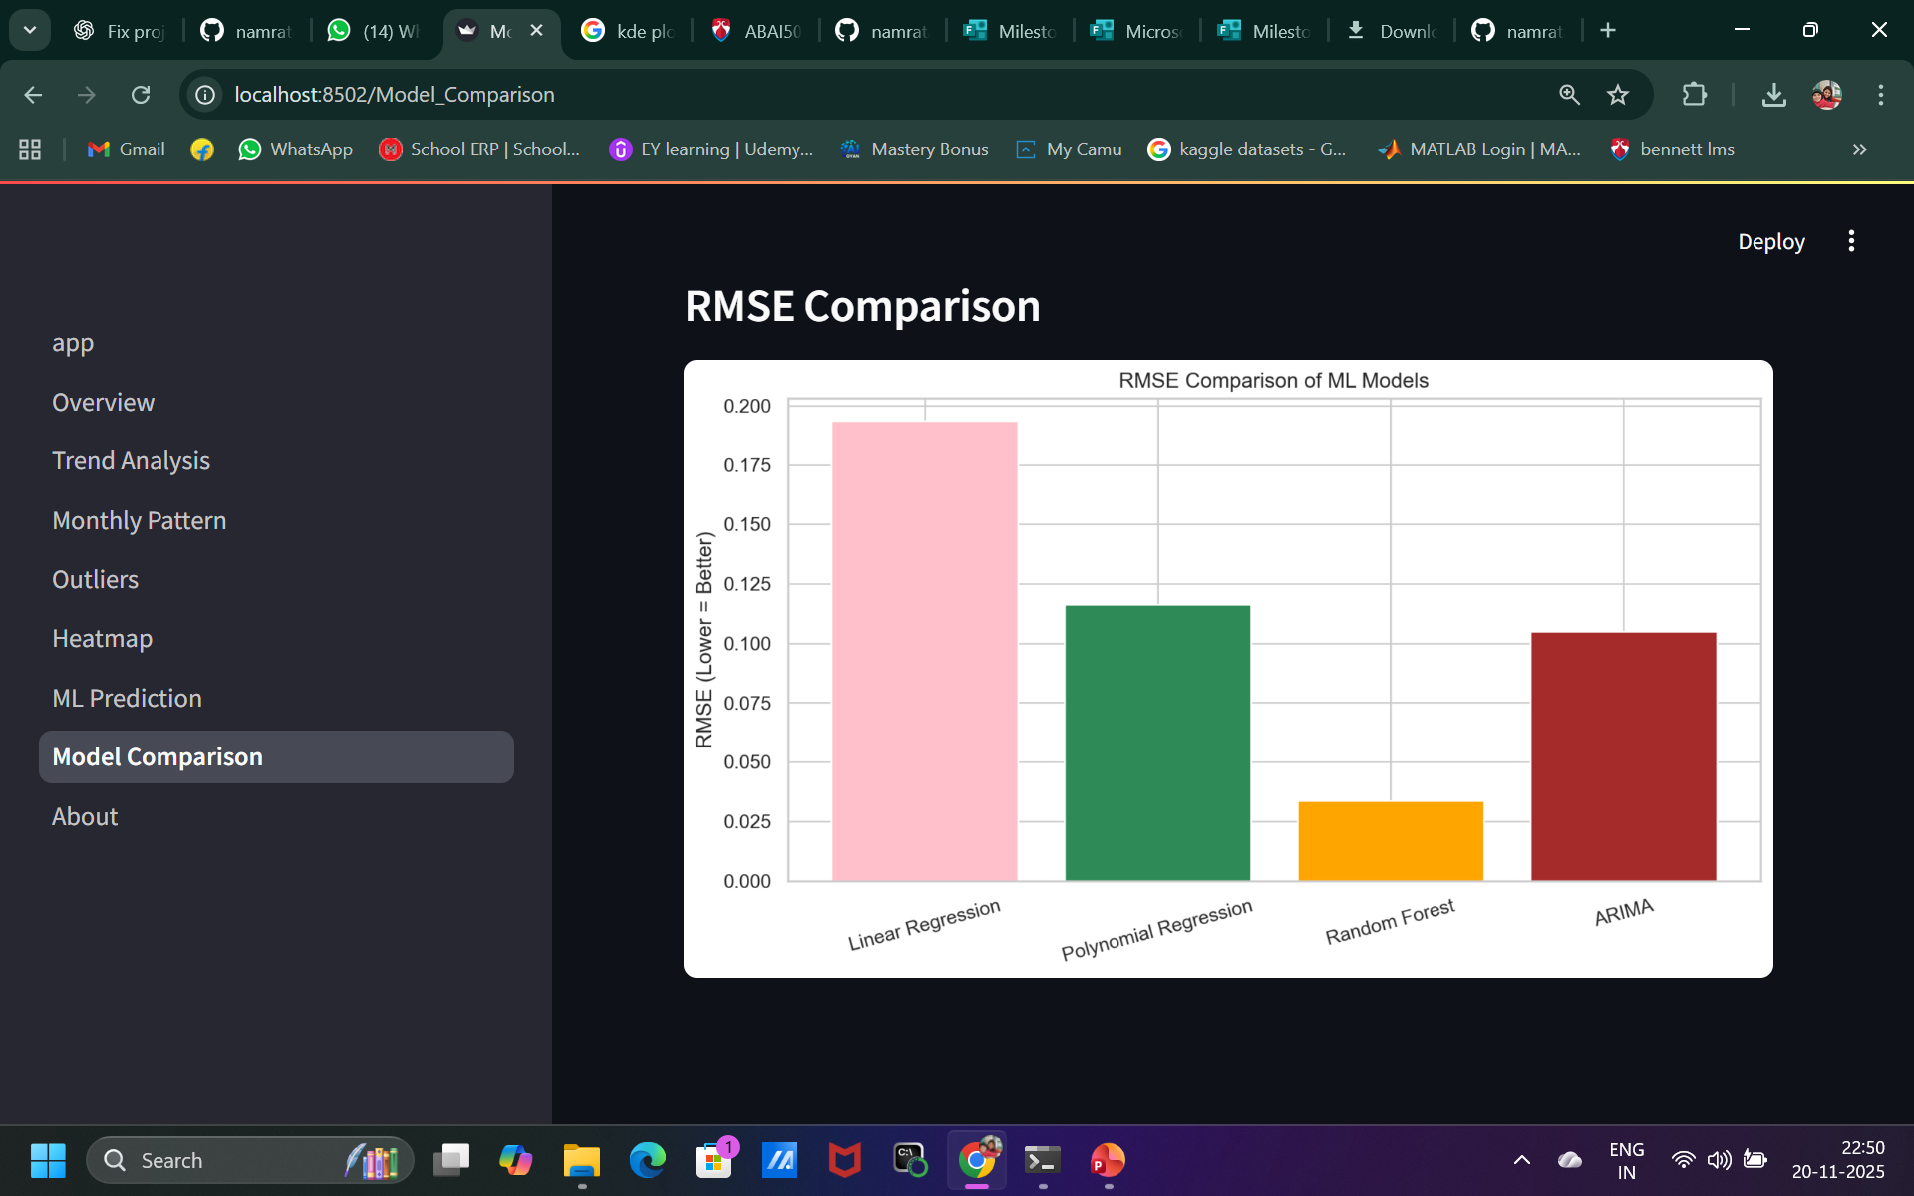
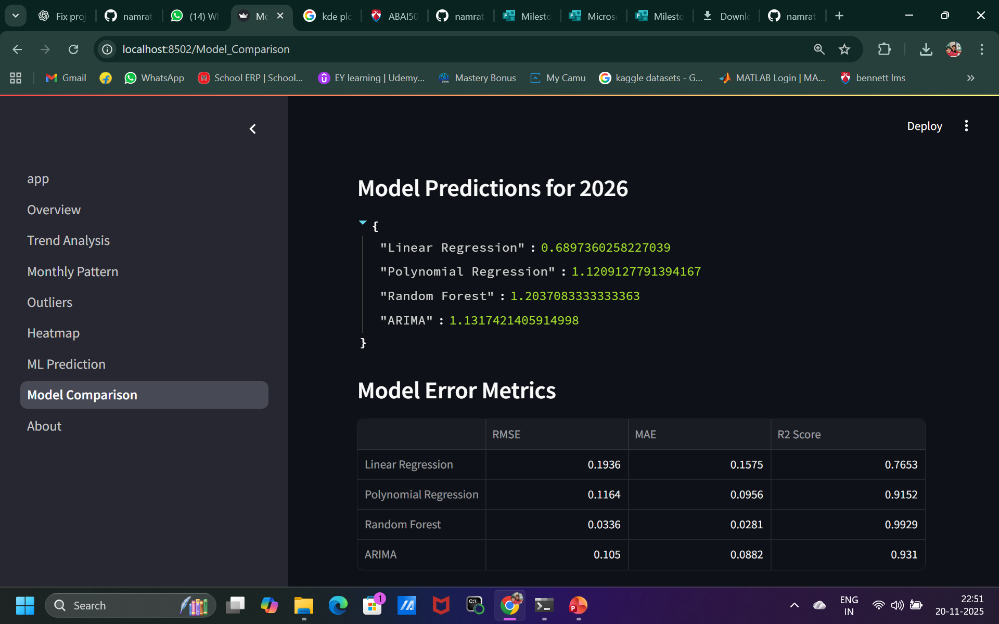
Model Comparison
"Linear Regression":0.6897360258227039
"Polynomial Regression":1.1209127791394167
"Random Forest":1.2037083333333363,
“ARIMA":1.1317421405914998

Slide 9
Conclusion
Global temperature anomalies show a clear rising trend
Climate warming has accelerated sharply since 1980
ML models predict continuous warming in coming decades
Polynomial & ARIMA models provide best accuracy

Slide 10
Thank You

